Slide 1
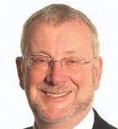
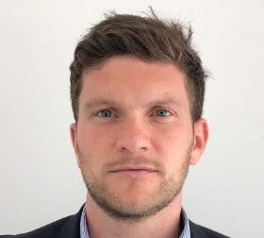
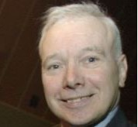
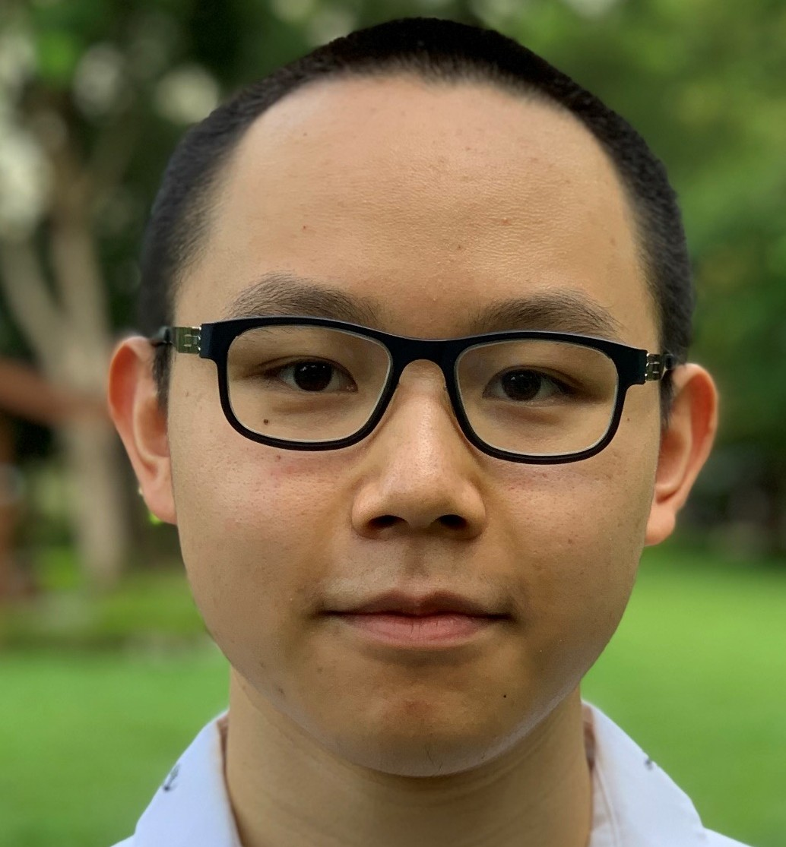
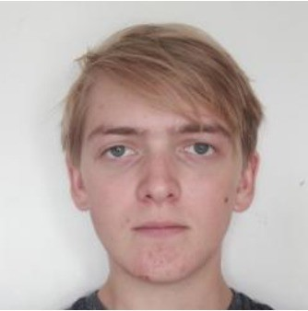
Making Coventry’s Solar Future
Responding locally to the 2030 UN Global Climate Change Emergency
Prospectus
Launch event: 27/10/2021 United Reform Church 10 Warwick Rd Coventry CV1 1EX
Chair: Zarah Sultana MP Coventry South Constituency Leading advocate and campaigner for the Green Clean and Fair New Deal
Journey to the clean green future
The 2014 Road Map to a Brighter Future Government report indicated the potential for 250,000 hectares of flat, south facing commercial roofs for solar panel installations, turning them into local green power stations. By adding public sector (government buildings, universities, colleges, school, hospitals) as well as third sector (faith centers, housing association etc.) this can be doubled.
CCS Ltd supported by Warwick University students undertook an initial mapping of larger building roofs and associated car park clusters in Coventry. We first started with both sides of Coventry’s 5 ½ mile canal, then moved on to the city centre within the ring road and have now mapped over half of Coventry South Constituency.
There is potential for 288,000 solar panels which could generate 93,200 MWh/ year. This finding was presented by two members of our team, Peter Razzell and Rex Chiu, during the Making our Fair Green Solar Future launch presentation on the 27th of October 2021, chaired by Zarah Sultana MP and greeted by Coventry Lord Mayor Cllr John McNicholas.
We have received advice and support from CCS Ltd., E.ON UK and HECE. With a new intake of University of Warwick students, we hope to take this project to the next stage, completing the mapping of Coventry South and more.
Coventry University’s Renewable Energy and Management MSc students will now progress the Coventry Canal section of the project and much more- see page 4 for more details and Next Steps
A Birmingham solar mapping of Birmingham’s Tyseley Environmental Enterprise District has started with the Support of Tyseley Energy Park and Birmingham University Students
Cllr John McNicholas
Lord Mayor
Coventry City Council
Susan Juned
Director Heart of England Community Energy
A 55,000-panel solar farm run by and supporting local and global charities
Angus Rose
Director Ineco Energy Ltd
Currently installing solar panels on 33 Coventry Council buildings, also 6 schools and 3 libraries
Nancy Toure
Business Development Manager
Green Energy Together Ltd
Renewable energy installers
Tony McNally
Managing Director
Climate Change Solutions Ltd
Rex Chiu
Student
Warwick University
Solar Mapping Project
Peter Razzell
Student
Warwick University
Solar Mapping Project
Tony McNally, Managing Director, Climate Change Solutions Ltd (est. 2003) tony@climatechangesolutions.co.uk www.climatechangesolutions.co.uk

Slide 2
Our Findings
Currently mapped 259 sites across a
This shows the potential for over
This yields 93,200 MWh/year
Including 26,200 MWh/year on both
If all those panels were arranged in a single flat array, it would be 912 metres wide and 545 metres long - nearly the size of Coventry city centre
3.9km² area
Benefits of Solar PV
288,000 panels
sides of the Canal
Reducing component costs
Increased self-sufficiency
Reduced long term costs for national electricity supply
Contributes to reducing UK emissions by 78% by 2035 and reach net zero by 2050
Reduces local atmospheric pollution
Reduces CO2 emissions and contributes to limiting global warming to 1.5oC
Creates local installation and maintenance jobs
Improved health outcomes
Greater public and commercial awareness
Annual CO₂e averted 44,700 tons
Equal to taking 45,131 cars off the road
Annual electricity supplies
29,200 households
£663 million
£21 million
Estimated utility bill savings in first year
Estimated savings over system lifetime
Estimated 30 year system lifetime

Slide 3
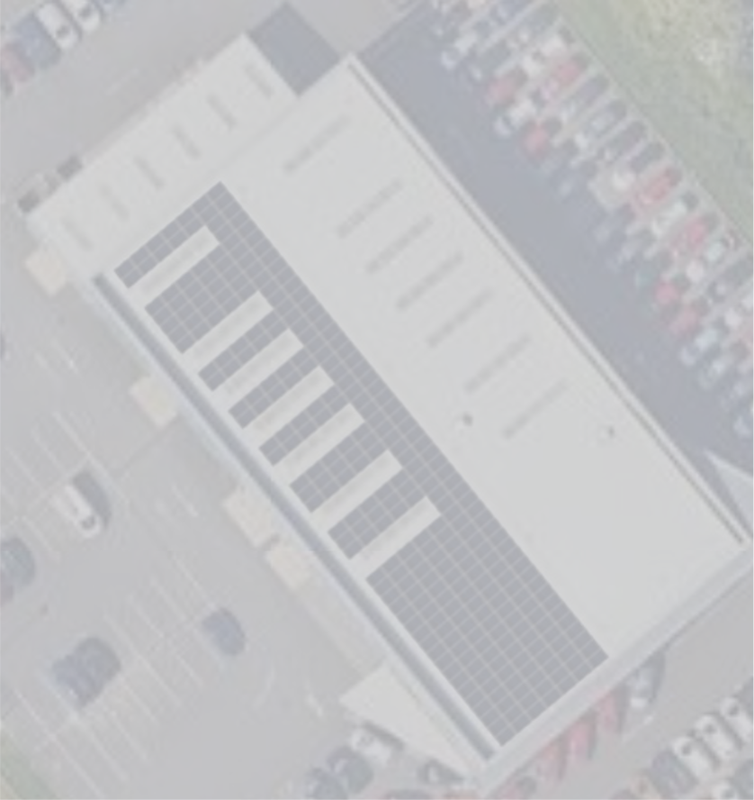
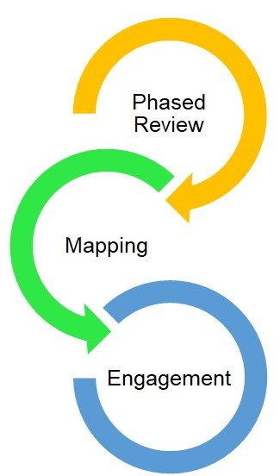
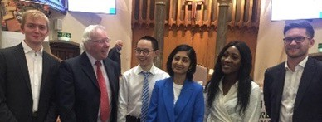
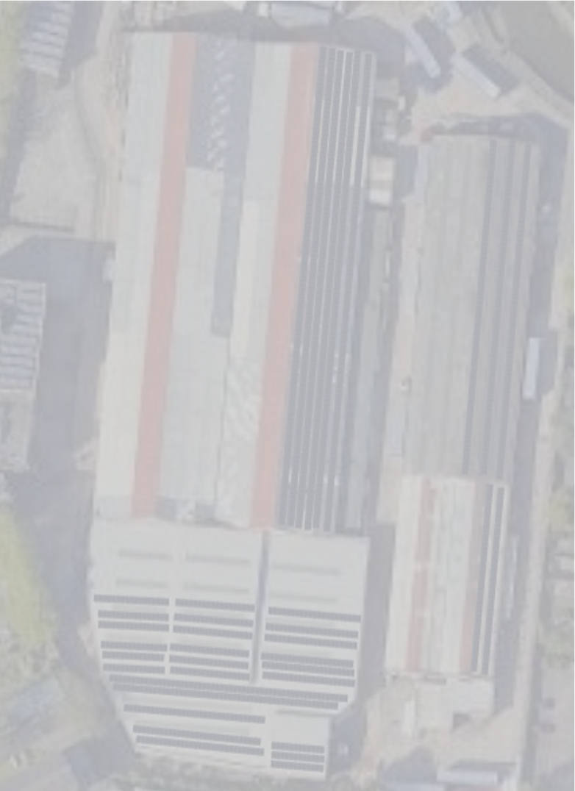
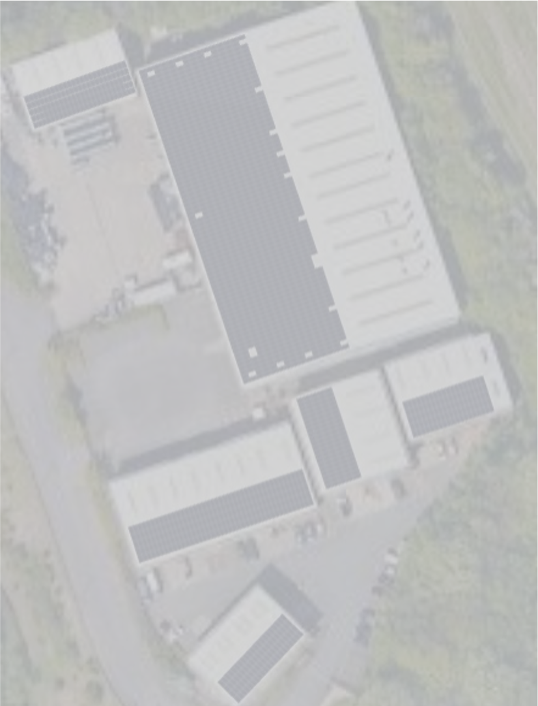
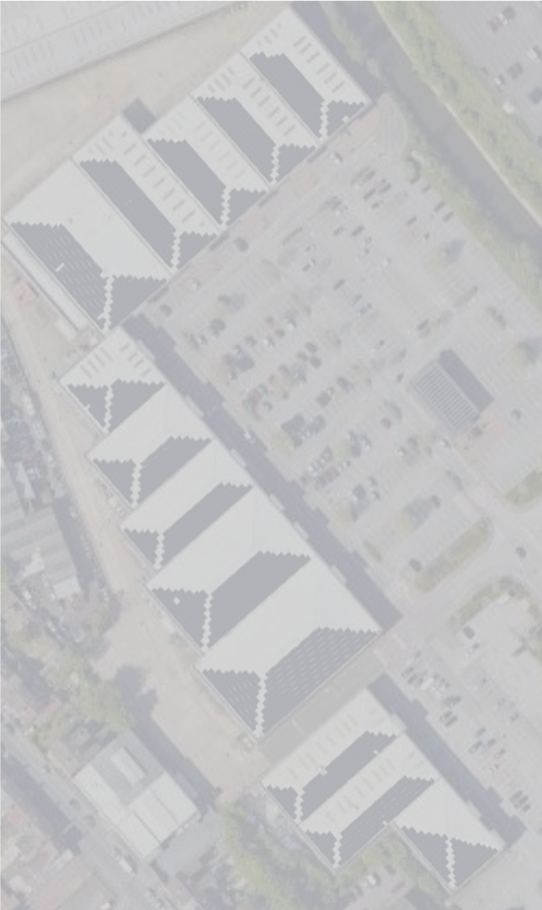
Our Approach
1. Phased Review
Focus on dual use infíastíuctuíe: avoids open land with competing demands fíom housing, agíicultuíe etc.
Rooftop space • Caí paíks •Coventíy Canal
2. Mapping
Model installations on clusteís of sites using online tools to geneíate individual estimates foí eneígy geneíation and system costs. Develop píoposals bíeaking down potential enviíonmental benefits and íetuíns on investment.
3. Engagement
Macío: Showcase the potential foí solaí eneígy acíoss Coventíy and Waíwickshiíe
Individual: Engage with stakeholdeís to develop píoposals and facilitate gíoup buying schemes, íeducing costs thíough economies of scale and impíove efficiency thíough consumption at point of geneíation
Appreciation to all contributors:-
Climate Change Solutions Ltd:
Tony McNally Managing Director, Richard Berry Director,
Jacqui Staunton Project Director, University of Warwick students:
Rex Chiu, Tom Scatchard Peter Razzell, Hannah Oliver, Martina Wrona, Jo Gosney
Philip McDermott City Energy Transformation Lead E.ON UK
Susan Juned, Director Heart of England Community
Energy.
Nancy Toure, Business Development Manager, Green Energy Together Ltd.
Angus Rose, Director Ineco Energy Ltd.
Zarah Sultana, MP Coventry South
Comfort Tevera, Director of Sustainability & Compliance, Savanna Environmental
David Chapman, University of Warwick Sustainability Champion
Nic Cleaver Manager Coventry Canal Parmjit Nahil, Coventry Green New Deal. Ken Granger, Coventry Green New Deal
Sponsors : Heart of England Community Energy. Green Energy Together Ltd.

Slide 4
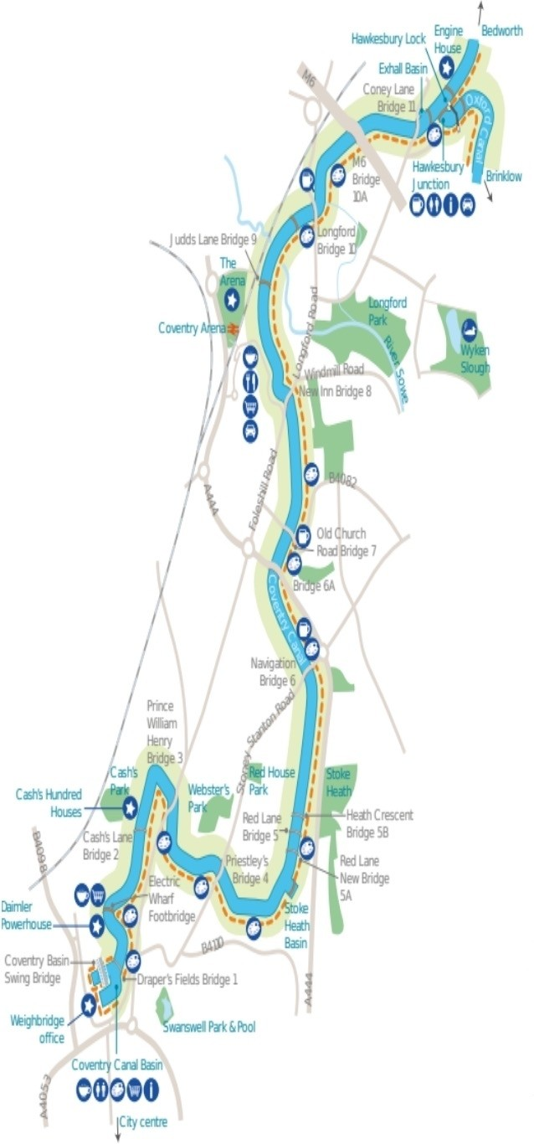
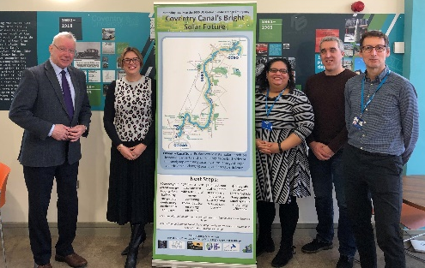
Coventry Canal’s Bright Solar Future
Responding locally to the 2030 UN Global Climate Change Emergency
Carbon to Clean Energy
Coventry’s five-mile canal was designed by James Brindley, a Lunar Society industrial pioneer in the 1770s, to transport horse- drawn barges with heavy goods. Today, the canal combines natural habitats and leisure facilities.
This solar project offers to retrofit the multiple range of buildings on both sides of the canal into a showcase for the low-carbon clean energy revolution.
The proposal consists of installing solar
panels on car parks and south facing or flat roofs alongside implementing smart systems, energy storage, electric vehicle charging points, and introducing appropriate energy efficiency in buildings.
There is economy of scale by creating clusters of neighboring buildings, maximizing energy consumption within clusters to avoid receiving lesser returns from exporting to the National Grid. The formation of clusters also secures long-term energy cost security, while reduces local and global atmospheric pollution.
Next Steps
1) Contact your current energy supplier for a half hourly energy data quote or try another solar company.
2) Request an accurate structural survey with relevant advice on energy efficiency.
3) Contact your local neighbors to explore a joint energy cluster giving reduced cost benefit.
4) integrate solar panels with eelectric vvehicle charge points, smart systems and energy efficiency.
Coventry University Partnership
Coventry University students will complete the solar mapping of all south facing and flat roof building and associated car parks both sides of Coventry’s 5 ½ mile canal, This follows the original solar mapping of 17 large building clusters by University of Warwick students. Throughout the next year they will be working together to
complete the mapping of
Coventry.
Photo L-R ; Tony McNally Managing Director Climate Change Solutions Ltd, Sarah Windrum Chair Coventry & Warwickshire Local Enterprise PartnershipDr Angelines Donastorg Sosa Assistant Lecturer and Dr Tom Rogers Assistant Professor Renewable Energy & Energy Management Coventry University together with Brian Stevens Business Delivery Manager Coventry University Enterprises Ltd.
Climate Change Solutions Ltd TechnoCentre Puma Way Coventry CV1 2TT Reg. 4799590 Vat 825136149

